Slide 1

DATA TALK
Introduction
Definitions
Types
Process
Skills
Roadmap
Questions

Slide 2
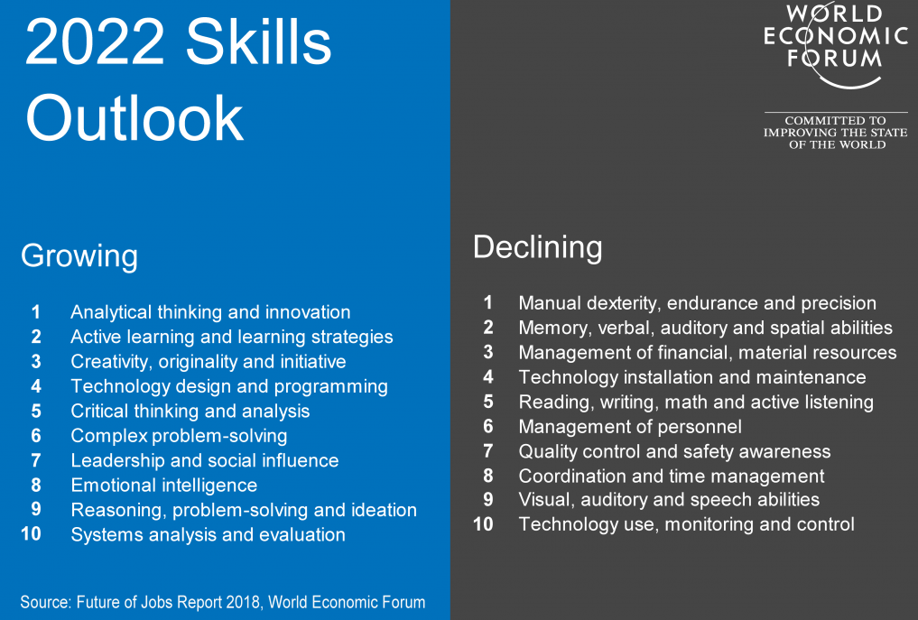
Introduction: WEF 2022 Skills Outlook

Slide 3
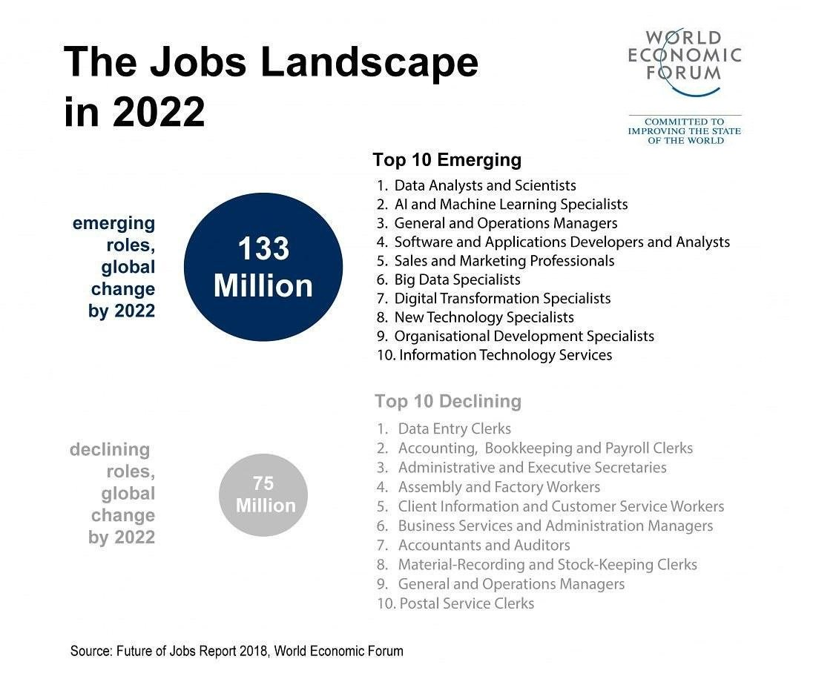
Introduction

Slide 4
What is Data?
Data means different things to different data users, scholars and experts. One thing consistent to all stakeholder is the final output derived form data- INFORMATION.
Data is limitless and an integral part of every activity we engage in everyday. From e-mails to social media and e-commerce platforms one can only conclude that data is simply the future of ground breaking innovations.
Now let us give data a definition:

Slide 5

What is Data?
DATA IS SIMPLY;
1. Facts and Statistics collected together for reference or analysis
2. An assumption or a premise where inferences are done
3. Data is a set of values of qualitative or quantitative variables. Source: Wikipedia
4. Information in raw or unorganized form (such as alphabets, numbers, or symbols) that refer to, or represent, conditions, ideas, or objects
5. Data are values of qualitative or quantitative variables belonging to a set of items. Variables represent measurements of characteristics of an item.

Slide 6
What is Analytics?
Analytics is the systematic computational analysis of data or statistics. It entails applying data patterns towards effective decision-making. It can be valuable in areas rich with recorded information; analytics relies on the simultaneous application of statistics, computer programing and operations research to quantify performance. Source: Wikipedia
Analytics explores potential future events, it is the application of logical computation reasoning to the competent parts obtained in an analysis.

Slide 7
What is Data Analytics
Data analytics is process of inspecting, cleansing, transforming and modeling data with the goal of discovering useful information, informing conclusion and supporting decision making.
Data analytics professionals are one of the high income skills of the new decade aside copywriters, software and web engineers according to my research.
What exactly does a Data Analyst do?
A data analyst gathers data from different sources, discovers, interprets and communicates meaningful pattern and trends to stake holders for smart decisions to be made.

Slide 8
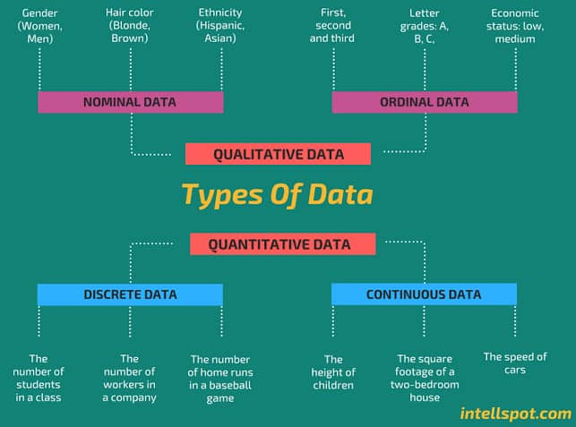
Types of Data

Slide 9
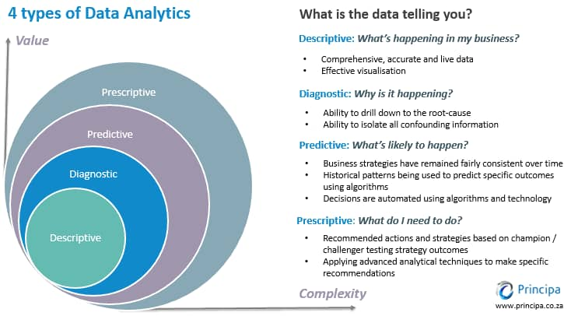
Types of Analytics

Slide 10
STEP TAKEN TO CARRY OUT A DATA ANALYTICS PROJECT
There are 6 main steps to carry out a Data Analytics project, note that the steps may vary from company to company or person to person:
I - Identifying problems
O - Obtaining data needed to solve the problems
U - Understanding the data gathered
P - Preparing the data
A - Analyzing the data
P - Presenting the analysis and giving recommendations
©www.data1academy.wordpress.com

Slide 11





SKILLS NEEDED TO BECOME A DATA ANALYST
Technical/Hard skills:
Microsoft Excel
Structured Query Language (SQL)
Microsoft Power BI
Tableau
Python
Statistics
Note:
You don’t need to learn every of these skill at once, you can learn some, work on projects, share your insights online, get a job and LEARN ON THE JOB.
©www.data1academy.wordpress.com

Slide 12
SKILLS NEEDED TO BECOME A DATA ANALYST
Soft skills:
Communication
Critical thinking and problem solving
Fast learning
Attention to details
Good listening
Domain knowledge
As a business student/young professional in the data space, your goal should be to solve business problems with data. This can be done by asking the right questions.
©www.data1academy.wordpress.com

Slide 13
HOW TO BECOME A DATA ANALYST
Here is a road map on how to become a Data Analyst
Learn the skills needed (online courses, boot camps, YouTube etc.)
Work on personal projects.
Build a simple portfolio to showcase your projects
Make use of social media to gain an online presence.
Review your Resume.
Apply for Data jobs via job banks, LinkedIn and other means.
You can also freelance on freelancing platforms like Upwork, Fiver.
©www.data1academy.wordpress.com

Slide 14
QUESTIONS & ANSWERS
QUESTIONS???
©www.data1academy.wordpress.com

